Slide 1



Noida Institute of Engineering and Technology, Greater Noida
Multivariable Calculus I
Unit: 4
MATHEMATICS – 1 (KAS – 103)
Dr. Akansha Singh
Affiliation from AKTU, Lucknow
Mathematics Department
B Tech 1st Sem

Slide 2
Content
Multiple integration: Double integral, Triple integral
Change of order of integration
Change of variables
Application: Areas and volumes, Center of mass (Constant and variable densities)
Improper Integral
Beta and Gama function
Dirichlet’s Integral
Solid of revolution

Slide 3
Course Objective
The use of multiple integral in finding area, volume, mass, centroid and moment of inertia of plane and solid regions.
The students will learn the essential concepts of multiple integration (Double integral, Triple integral), Change of order of integration, Change of variables, Areas and volumes, Center of mass and center of gravity (Constant and variable densities), in a comprehensive manner.

Slide 4
Course Outcomes 2020-21 (B. Tech. – 1st Sem)
Course Name: Mathematics-I (KAS 103)
CO1 | Remember the concept of matrices and apply for solving linear simultaneous equations
CO2 | Understand the concept of limit , continuity and differentiability and apply in the study of Rolle,s , Lagrange,s and Cauchy mean value theorem and Leibnitz theorems
CO3 | Identify the application of partial differentiation and apply for evaluating maxima, minima, series and Jacobians.
CO4 | Illustrate the working methods of multiple integral and apply for finding area, volume, centre of mass centre of gravity, evaluating surface areas and volumes.
CO5 | Understand the basic concept of Profit, Loss, Number & Series, Coding & decoding

Slide 5
Program Outcomes (PO)
Engineering knowledge: Apply the knowledge of mathematics, science, engineering fundamentals, and an engineering specialization to the solution of complex engineering problems.
2. Problem analysis: Identify, formulate, review research literature, and analyze complex engineering problems reaching substantiated conclusions using first principles of mathematics, natural sciences, and engineering sciences.
3. Design/development of solutions: Design solutions for complex engineering problems and design system components or processes that meet the specified needs with appropriate consideration for the public health and safety, and the cultural, societal, and environmental considerations.
4. Conduct investigations of complex problems: Use research-based knowledge and research methods including design of experiments, analysis and interpretation of data, and synthesis of the information to provide valid conclusions.

Slide 6
Program Outcomes (PO)
5. Modern tool usage: Create, select, and apply appropriate techniques, resources, and modern engineering and IT tools including prediction and modeling to complex engineering activities with an understanding of the limitations.
6. The engineer and society: Apply reasoning informed by the contextual knowledge to assess societal, health, safety, legal and cultural issues and the consequent responsibilities relevant to the professional engineering practice.
7. Environment and sustainability: Understand the impact of the
professional engineering solutions in societal and environmental
contexts, and demonstrate the knowledge of, and need for sustainable
development.
8. Ethics: Apply ethical principles and commit to professional ethics and
responsibilities and norms of the engineering practice.

Slide 7
Program Outcomes (PO)
9. Individual and team work: Function effectively as an individual, and as
a member or leader in diverse teams, and in multidisciplinary settings.
10.Communication: Communicate effectively on complex engineering
activities with the engineering community and with society at large,
such as, being able to comprehend and write effective reports and
design documentation, make effective presentations, and give and
receive clear instructions.
11.Project management and finance: Demonstrate knowledge and
understanding of the engineering and management principles and
apply these to one’s own work, as a member and leader in a team,
to manage projects and in multidisciplinary environments.
12. Life-long learning: Recognize the need for, and have the preparation
and ability to engage in independent and life-long learning in the
broadest context of technological change.

Slide 8
CO-PO Mapping 2020-21 (B. Tech. – 1st Sem)
Course Name: Mathematics-I (KAS 103)
CO | PO-1 | PO-2 | PO-3 | PO-4 | PO-5 | PO-6 | PO-7 | PO-8 | PO-9 | PO-10 | PO-11 | PO-12
CO1 | 3 | 2 | 1 | 1 | 3 | 2 | - | - | - | 2 | 2 | 3
CO2 | 3 | 3 | 2 | 3 | 3 | - | - | - | - | 2 | 3 | 3
CO3 | 3 | 2 | 3 | 3 | 3 | 2 | - | - | - | 2 | 3 | 3
CO4 | 3 | 2 | 3 | 3 | 2 | 2 | - | - | - | 2 | 2 | 3
CO5 | 1 | 1 | 1 | 1 | 1 | - | - | - | - | 2 | - | 3
Mean | 2.6 | 2 | 2 | 2.2 | 2.4 | 2.0 | - | - | - | 2 | 2.5 | 3

Slide 9
Prerequisite and Recap
Function of one and two variables
Basic knowledge of differentiation and integration

Slide 10
Multiple Integral (CO 4)
Objective
Multiple Integrals are used to evaluate area, volume, mass, moment of inertia of plane & solid region.

Slide 11
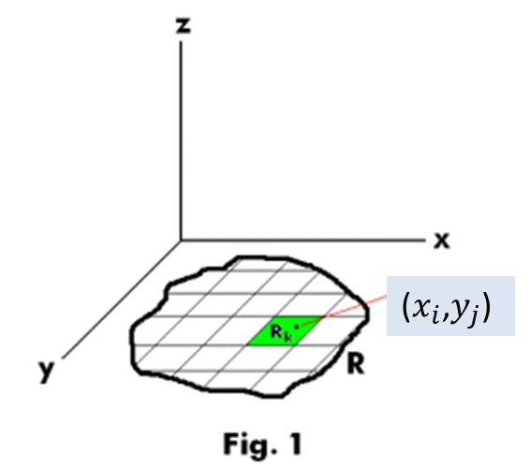
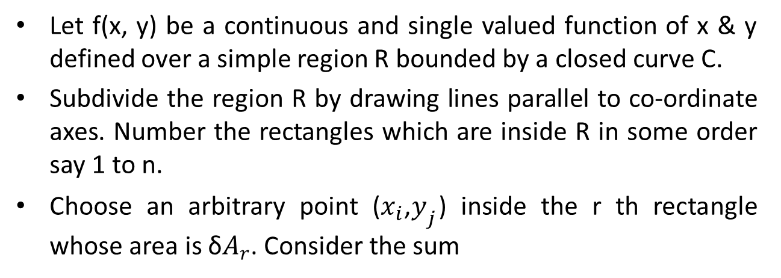
Double Integral (CO 4)
Let f(x, y) be a continuous and single valued function of x & y defined over a simple region R bounded by a closed curve C.
Subdivide the region R by drawing lines parallel to co-ordinate axes. Number the rectangles which are inside R in some order say 1 to n.
Choose an arbitrary point ($x_{i}$,$y_{j}$) inside the r th rectangle whose area is δ$A_{r}$. Consider the sum

Slide 12
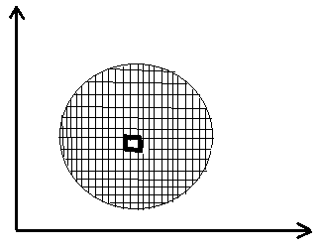
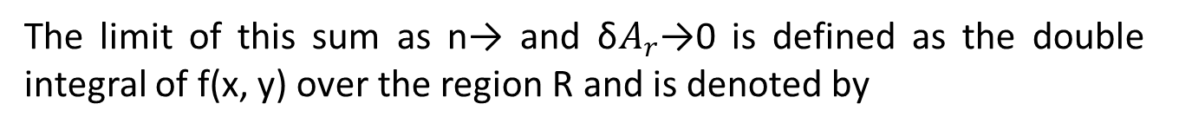
Evaluation of Double Integration (CO 4)
The limit of this sum as n→ and δ$A_{r}$→0 is defined as the double integral of f(x, y) over the region R and is denoted by

Slide 13
Evaluation of Double Integration (CO4)
CASE I :
Let the region R be the rectangular region expressed in the form
In this case the limits, both for x and y is constants, so it is immaterial
whether we first integrate w.r.t. x, or w.r.t. y.
Note: The two approaches yield the same answer.

Slide 14
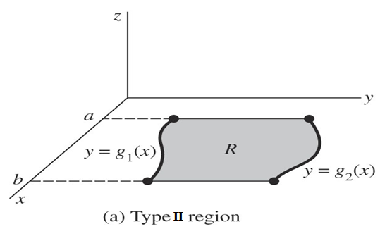
Evaluation of Double Integration (CO4)
CASE 2 :
Let the region R be expressed in the form
In this case the limits of x are constants, but for y limits are as functions of x, so here we first integrate w.r.t.y and then w.r.t.x. Thus

Slide 15
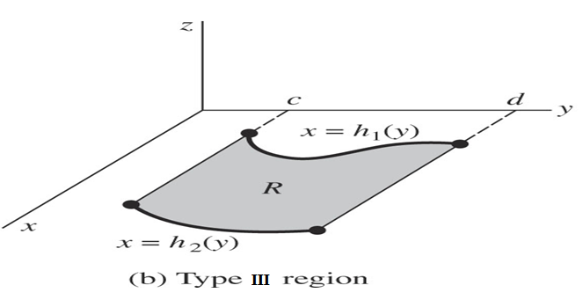
Evaluation of Double Integration (CO4)
CASE 3 :
Let the region R be expressed in the form
In this case the limits of y are constants, but for x limits are as functions of y, so here we first integrate w. r. to x and then w.r.to y. Thus

Slide 16
Triple Integral (CO 4)
Now we know that how to integrate over a two-dimensional region. We’ll use triple integral to integrate over a three dimensional region. The notation for the general triple integrals is
CASE 1: If the limits of x, y, z all are constants-
CASE 2: The limits involving two variables are kept innermost, and then limit involving one variable and finally the constant limits.

Slide 17
Example 1
Question:
Solution:

Slide 18
Example 2
Question:
Solution:

Slide 19
Example 3
Question:
Solution:

Slide 20
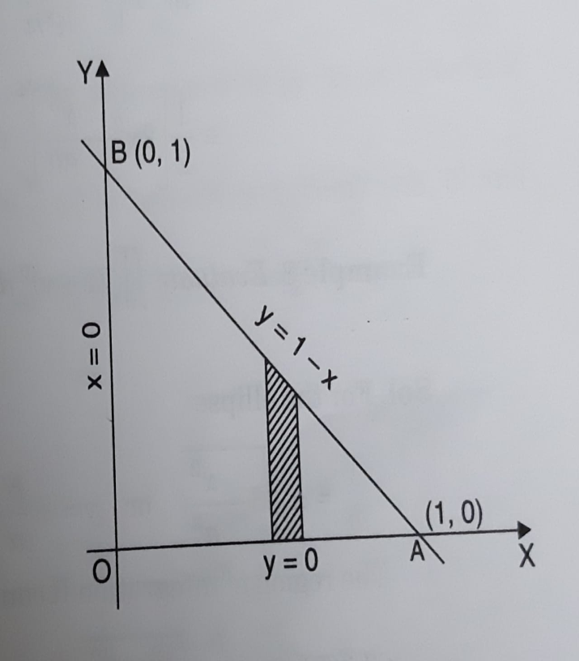
Example 4
Question:
Solution:

Slide 21
Example 4 Contd…

Slide 22
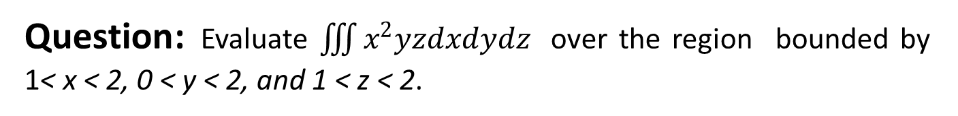
Example 5
Question: Evaluate $\iiint{x^{2}yzdxdydz }$over the region bounded by 1< x < 2, 0 < y < 2, and 1 < z < 2.
Solution:

Slide 23
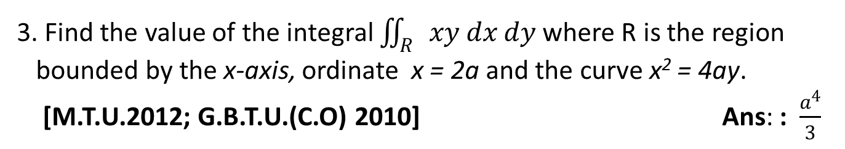
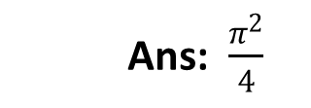
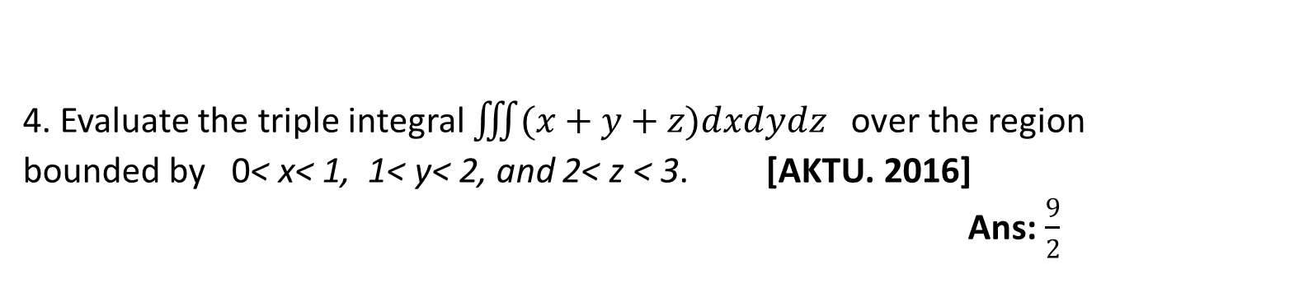
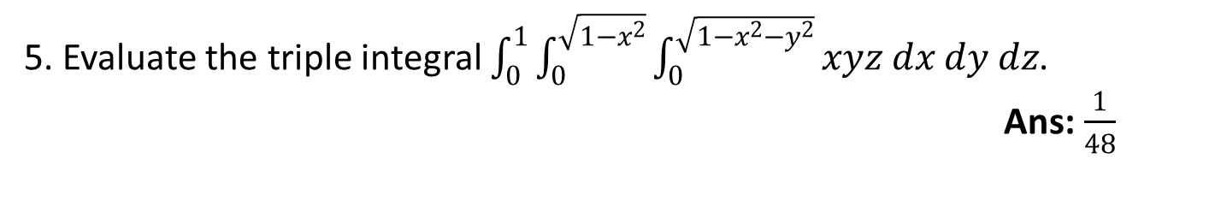
FAQ
1. Evaluate $\int_{0}^{1}{\int_{y^{2}}^{y}{\left(1+xy^{2}\right) dx dy}}$ [G.B.T.U. 2010] Ans: $\frac{41}{210}$
Ans: $\frac{π^{2}}{4}$
3. Find the value of the integral $\iint_{R}{xy dx dy}$ where R is the region
bounded by the x-axis, ordinate x = 2a and the curve x² = 4ay.
[M.T.U.2012; G.B.T.U.(C.O) 2010] Ans: : $\frac{a^{4}}{3}$
4. Evaluate the triple integral $\iiint{(x+y+z)dxdydz }$over the region bounded by 0< x< 1, 1< y< 2, and 2< z < 3. [AKTU. 2016]
Ans: $\frac{9}{2}$
5. Evaluate the triple integral $\int_{0}^{1}{\int_{0}^{\sqrt{1−x^{2}}}{\int_{0}^{\sqrt{1−x^{2}−y^{2}}}{xyz dx dy dz}}}$.
Ans: $\frac{1}{48}$

Slide 24
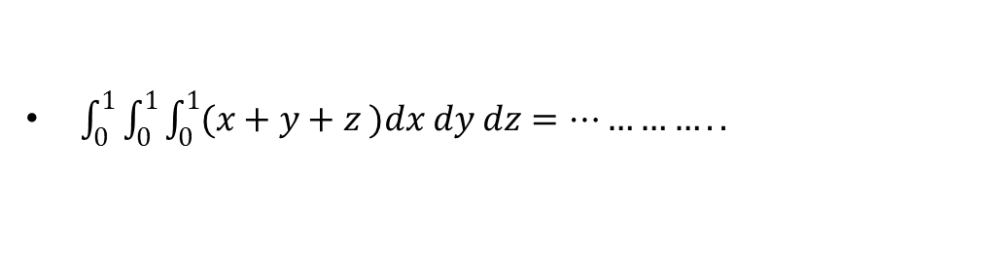
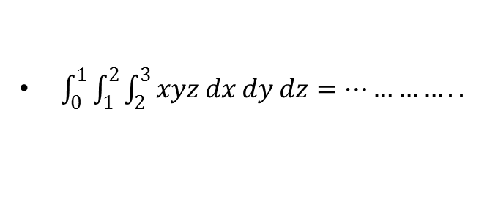
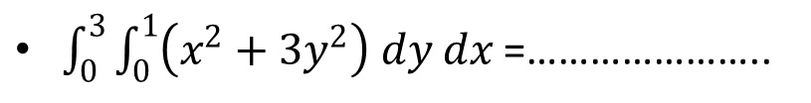
Quiz
$\int_{0}^{3}{\int_{0}^{1}{\left(x^{2}+3y^{2}\right) dy dx}}$ =…………………..
$\int_{0}^{1}{\int_{0}^{1}{\int_{0}^{1}{(x+y+z )dx dy dz}}}=…………..$
$\int_{0}^{1}{\int_{1}^{2}{\int_{2}^{3}{xyz dx dy dz}}}=…………..$

Slide 25
Faculty Video Links, Youtube & NPTEL Video Links and Online Courses Details
Double Integral
NPTEL: Lecture 17 – Double Integral
https://www.youtube.com/watch?v=3BbrC9JcjOUhttps://www.youtube.com/watch?v=3BbrC9JcjOU
NPTEL: Lecture 30 – Double Integral
https://www.youtube.com/watch?v=-DduB46CoZY
Triple Integral
NPTEL: Lecture 22– Triple Integral
https://www.youtube.com/watch?v=VvKAuFBJLs0

Slide 26
Recap
Double Integral
Triple Integral

Slide 27
Change of order of integration (CO 4)
Objective
Sometimes evaluation of double integral become easier by changing the order of integration. e.g.

Slide 28
Change of order of integration (CO 4)
To change the order of integration first, draw the region of integration with the help of limits of integration.
Secondly, draw vertical or horizontal strips as per the required order of integration.

Slide 29
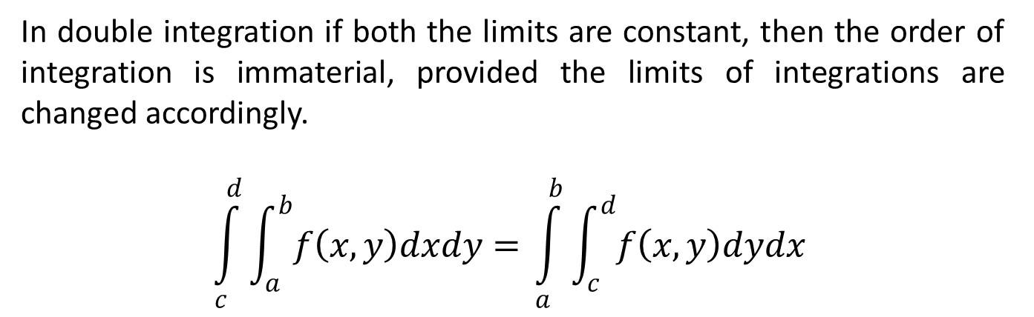
Change of order of integration (CO 4)
Case 1: If both the limits are constant
In double integration if both the limits are constant, then the order of integration is immaterial, provided the limits of integrations are changed accordingly.
$$\int_{c}^{d}{\int_{a}^{b}{f\left(x,y\right)dxdy= }}\int_{a}^{b}{\int_{c}^{d}{f\left(x,y\right)dydx }}$$

Slide 30
Change of order of integration (CO 4)
Case 2: Suppose the limits for inner integration are functions of any variable
Identify the region of integration of double integration.
Convert the given double integral into its equivalent double integral by changing the order of integration.
Find the new limits of integration.
After finding the new limits, evaluate the integral.

Slide 31
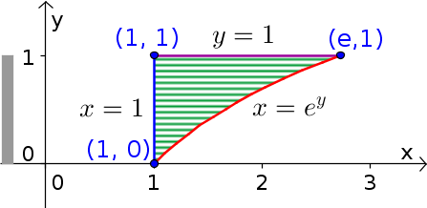
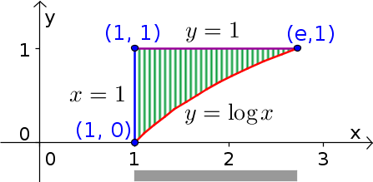
Example 1
Question: Change the order of integration
Solution:
First we draw the limits of integral. Here limit of x is in
variable terms and limits of y are constant (horizontal strip). So for changing order we consider vertical strip .

Slide 32
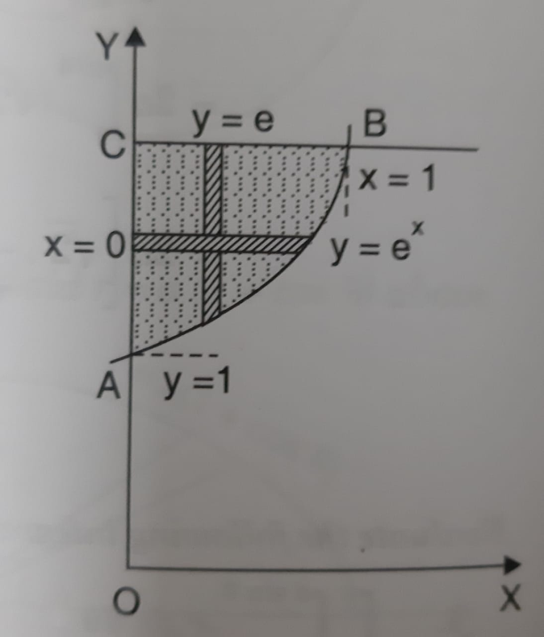
Example 2
Question: Change the order of integration
Solution:
According to given limits region bounded by following curves:
It can also be considered as bounded by following curves:

Slide 33
Example 2 Contd…

Slide 34
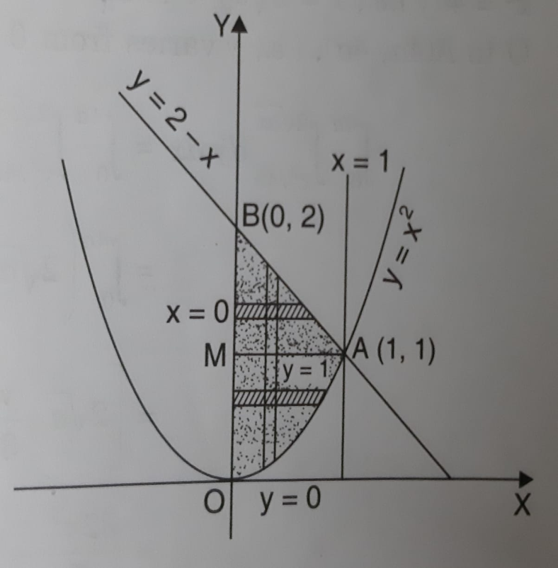
Example 3
Question: Change the order of integration and evaluate
Solution:
According to given limits region bounded by following curves:

Slide 35
Example 3 Contd…

Slide 36
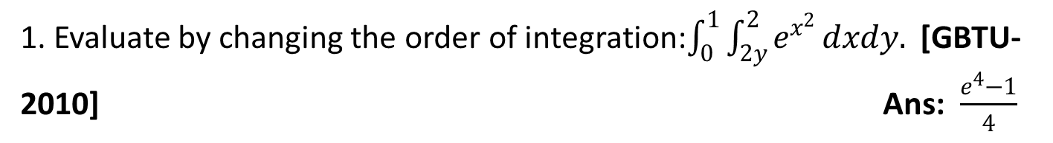
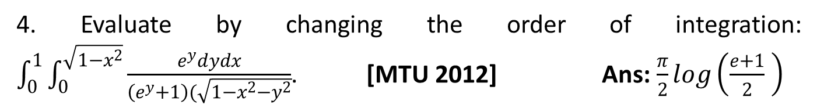
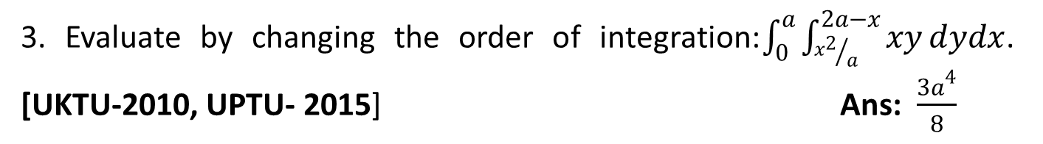
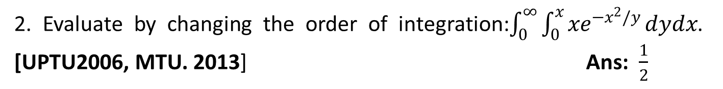
FAQ
1. Evaluate by changing the order of integration:$\int_{0}^{1}{\int_{2y}^{2}{e^{x^{2}}}}dxdy.$ [GBTU-2010] Ans: $\frac{e^{4}−1}{4}$
2. Evaluate by changing the order of integration:$\int_{0}^{∞}{\int_{0}^{x}{{xe}^{{−x}^{2}/y}}}dydx$. [UPTU2006, MTU. 2013] Ans: $\frac{1}{2}$
3. Evaluate by changing the order of integration:$\int_{0}^{a}{\int_{{x^{2}}/a}^{2a−x}{xy}}dydx$. [UKTU-2010, UPTU- 2015] Ans: $\frac{{3a}^{4}}{8}$
4. Evaluate by changing the order of integration: $\int_{0}^{1}{\int_{0}^{\sqrt{1−x^{2}}}{\frac{e^{y}dydx}{\left(e^{y}+1\right)(\sqrt{1−x^{2}−y^{2}}}}}$. [MTU 2012] Ans: $\frac{π}{2}log\left(\frac{e+1}{2} \right)$

Slide 37

Quiz
After changing order $\int_{0}^{1}{\int_{2y}^{2}{e^{x^{2}}}}dxdy$imits are………………..
After changing order $\int_{0}^{a}{\int_{{x^{2}}/a}^{2a−x}{xy}}dydx$ limits are………………..
After changing order $\int_{0}^{a}{\int_{0}^{\sqrt{a^{2}−y^{2}}}{(x^{2}+y^{2})}}dxdy$ limits are………………..

Slide 38
Faculty Video Links, Youtube & NPTEL Video Links and Online Courses Details
Change of order of integration
NPTEL: Lecture 21– Change of order of integration
https://www.youtube.com/watch?v=4rc3w1sGoNU

Slide 39
Recap
Change of order of integration
Evaluate integrals

Slide 40
Change of Variables in Multiple Integrals (CO 4)
Objective
When solving integration problems, we make appropriate substitutions to obtain an integral that becomes much simpler than the original integral.
We also used this idea when we transformed double integrals in rectangular coordinates to polar coordinates and transformed triple integrals in rectangular coordinates to cylindrical or spherical coordinates to make the computations simpler.

Slide 41
Change of Variables in Multiple Integrals (CO 4)
Let the variables x, y be replaced by new variables u, v by the transformation
then

Slide 42
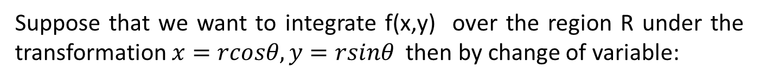
Change of Variables Polar Form (CO4)
Suppose that we want to integrate f(x,y) over the region R under the transformation $x=rcosθ, y=rsinθ$ then by change of variable:
then

Slide 43
Change of Variables Spherical Form (CO 4)
Suppose that we want to integrate f(x,y,z) over the region V under the transformation Cartesian to spherical form:
then

Slide 44
Change of Variables Cylindrical Form (CO4)
Suppose that we want to integrate f(x,y,z) over the region V under the transformation Cartesian to cylindrical form:
then

Slide 45
Example 1
Question:
Solution:

Slide 46
Example 1 Contd..

Slide 47
Example 2
Question:
Solution:

Slide 48
Example 2 Contd..

Slide 49
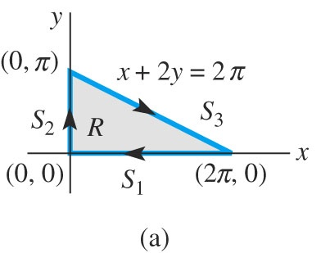
Example 3
Question:
Solution:
Let x+2y=u and x-2y=v

Slide 50
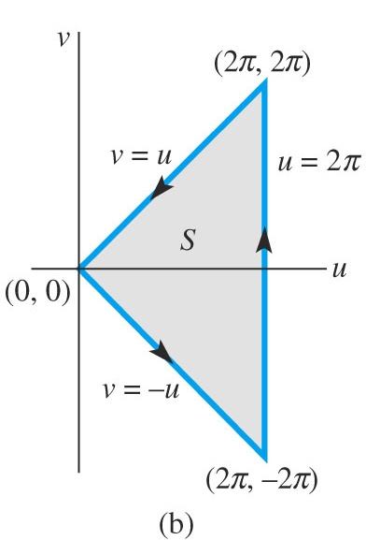
The Jacobian matrix is
Example 3 Contd…

Slide 51
Example 3 Contd…

Slide 52
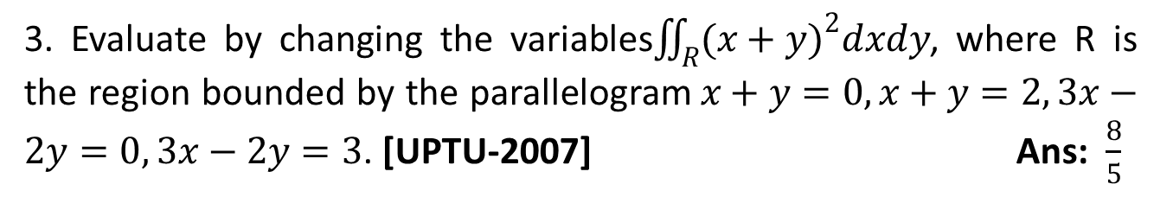
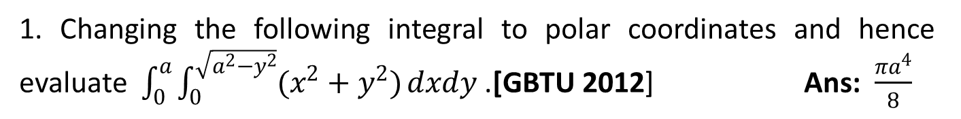
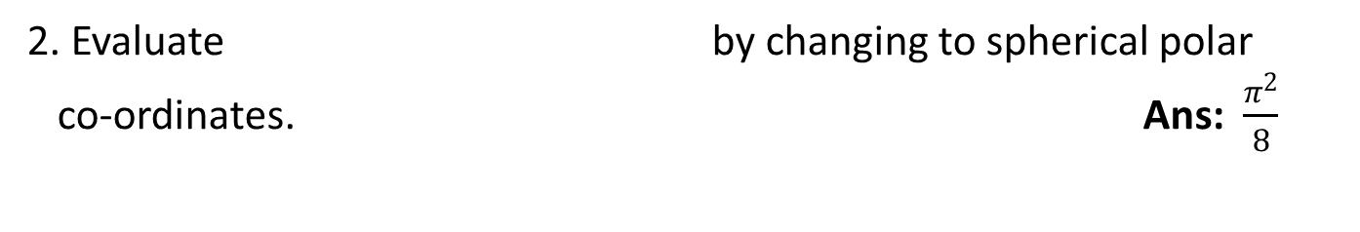
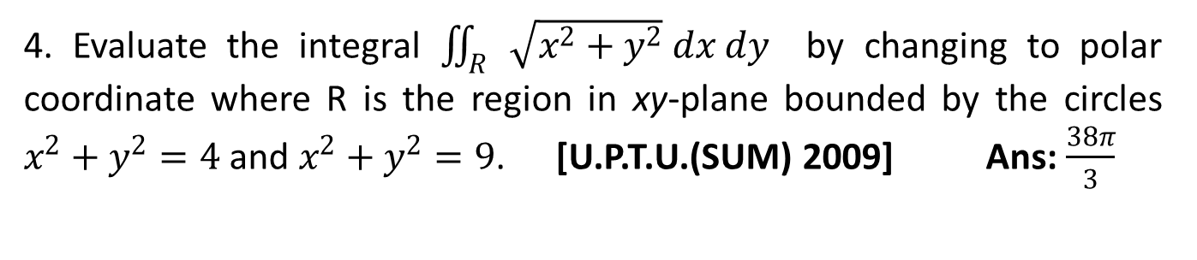
FAQ
1. Changing the following integral to polar coordinates and hence evaluate $\int_{0}^{a}{\int_{0}^{\sqrt{a^{2}−y^{2}}}{(x^{2}+y^{2})}}dxdy$ .[GBTU 2012] Ans: $\frac{{πa}^{4}}{8}$
2. Evaluate by changing to spherical polar
co-ordinates. Ans: $\frac{π^{2}}{8}$
3. Evaluate by changing the variables$\iint_{R}^{ }{{(x+y)}^{2}dxdy}$, where R is the region bounded by the parallelogram$x+y=0,x+y=2, 3x−2y=0, 3x−2y=3$. [UPTU-2007] Ans: $\frac{8}{5}$
4. Evaluate the integral $\iint_{R}{\sqrt{x^{2}+y^{2}} dx dy}$ by changing to polar coordinate where R is the region in xy-plane bounded by the circles $x^{2}+y^{2}=4$ and $x^{2}+y^{2}=9$. [U.P.T.U.(SUM) 2009] Ans: $\frac{38π}{3}$

Slide 53
Quiz
Replace x with …………………. in changing Cartesian to polar form .
Replace z with …………………. in changing Cartesian to spherical polar form .
C$hange the variable into polar form\int_{0}^{a}{\int_{0}^{\sqrt{a^{2}−y^{2}}}{(x^{2}+y^{2})}}dxdy$

Slide 54
Faculty Video Links, Youtube & NPTEL Video Links and Online Courses Details
Change of variable
NPTEL: Lecture 11– Change of variables
https://www.youtube.com/watch?v=X6kp2o3mGtA&t=1003s
NPTEL: Lecture 22– Change of variables in multiple integral
https://www.youtube.com/watch?v=wtY5fx6VMGQ&t=1151s
NPTEL: Lecture 35– Triple integrals
https://www.youtube.com/watch?v=-I3HUeHi1Ys&t=1933s

Slide 55
Recap
Change of variables
Polar form
Spherical form
Cylindrical form

Slide 56
Applications: Area and Volume (CO 4)
Objective
In engineering, volume and area are very important. With this we can figure out density, capacitance, flux, and many other things.
One very useful application of Integration is finding the area and volume of “curved” figures, that we couldn’t typically get without using Calculus.
Since we already know that can use the integral to get the area between the x- and y-axis and a function, we can also get the volume of this figure by rotating the figure around either one of the axes.

Slide 57
Applications: Area and Volume (CO 4)
Area as a Double integration:
Area of region R for Cartesian co-ordinates:
Volume as a Triple integration:
Volume V of region for Cartesian co-ordinates :

Slide 58
Applications: Centre of Mass (CO 4)
Centre of mass:
For a region R of a lamina with given density:

Slide 59
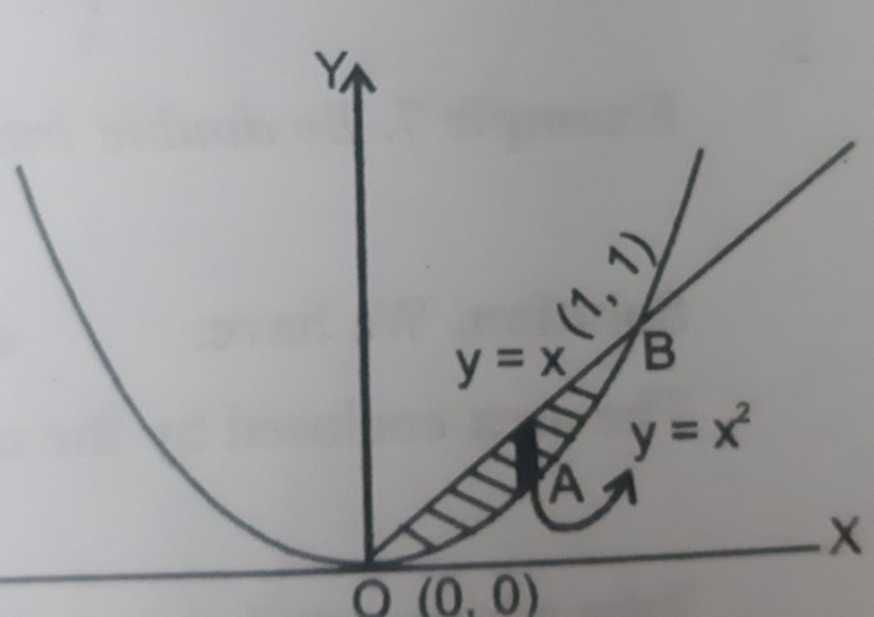
Example 1
Question:
Solution:

Slide 60
Example 1 Contd…

Slide 61
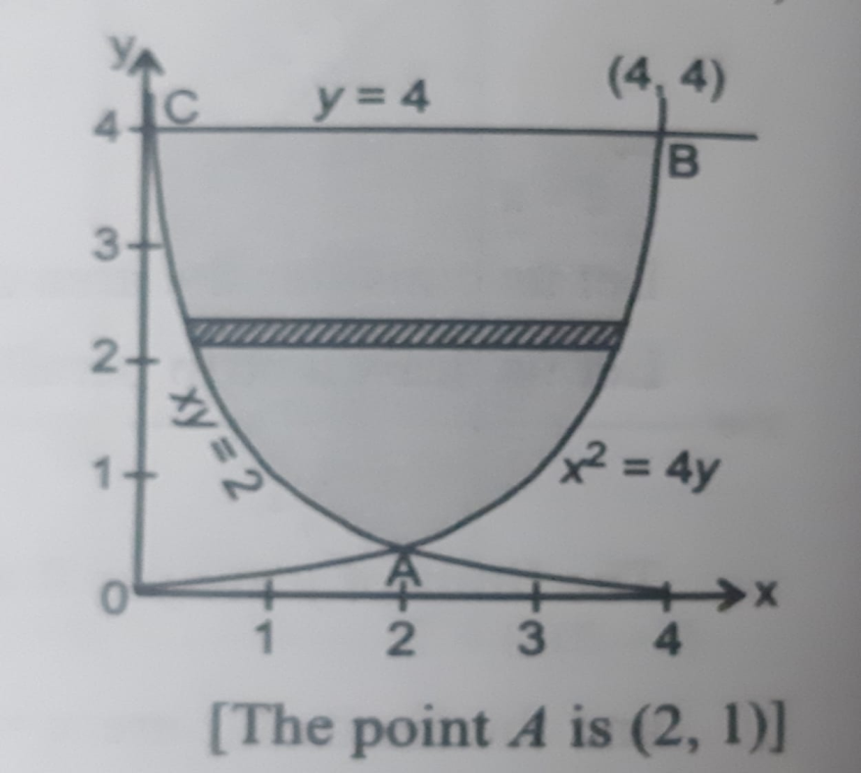
Example 2
Question:
Solution:

Slide 62
Example 2 Contd…

Slide 63
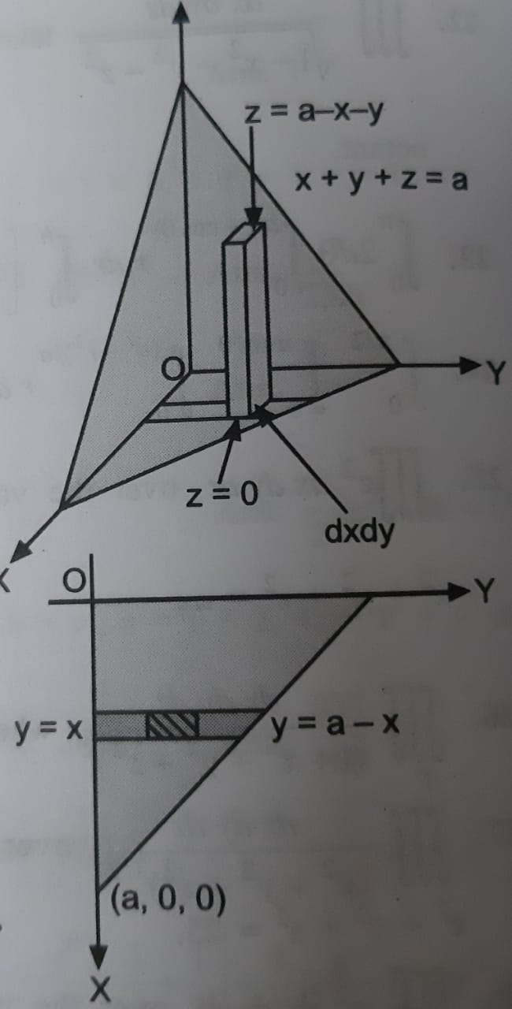
Example 3
Question:
Solution:

Slide 64
Example 3 Contd…

Slide 65
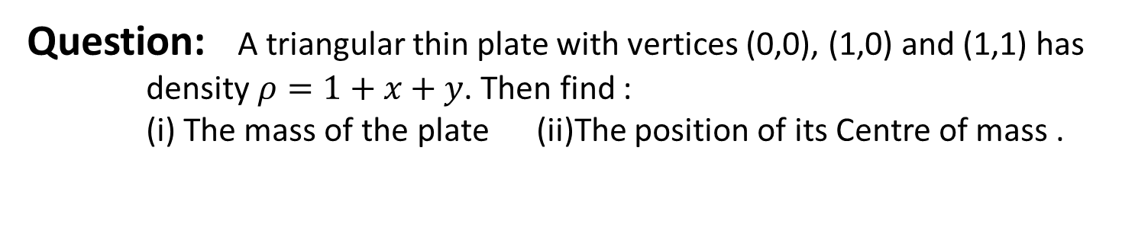
Example 4
Question: A triangular thin plate with vertices (0,0), (1,0) and (1,1) has
density $ρ=1+x+y$. Then find :
(i) The mass of the plate (ii)The position of its Centre of mass .
Solution:

Slide 66
Example 4 Contd…

Slide 67
Example 4 Contd…

Slide 68
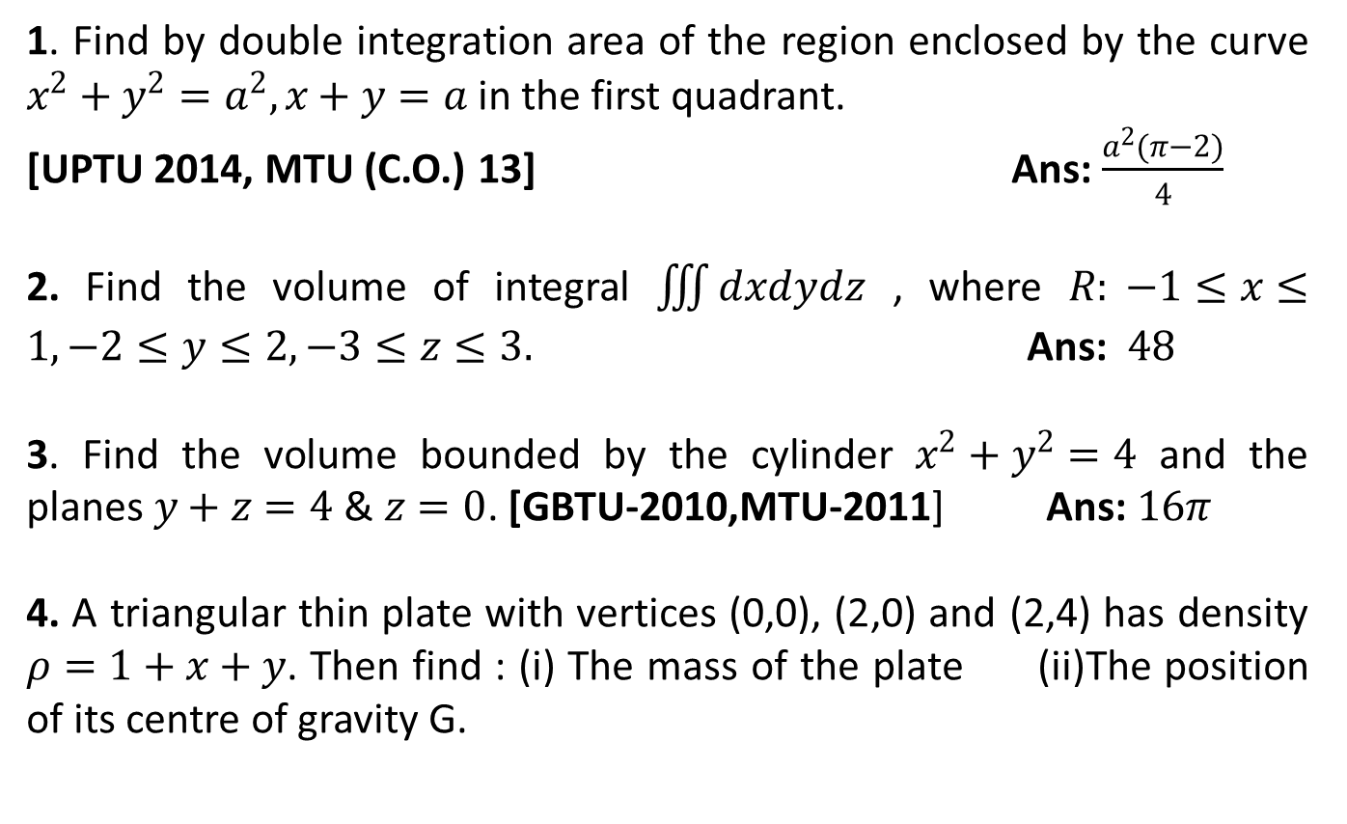
FAQ
1. Find by double integration area of the region enclosed by the curve $x^{2}+y^{2}=a^{2}, x+y=a$in the first quadrant.
[UPTU 2014, MTU (C.O.) 13] Ans: $\frac{a^{2}(π−2)}{4}$
2. Find the volume of integral $\iiint{dxdydz}$ , where $R: −1≤x≤1,−2≤y≤2,−3≤z≤3.$ Ans: $48$
3. Find the volume bounded by the cylinder $x^{2}+y^{2}=4$ and the planes $y+z=4$ & $z=0$. [GBTU-2010,MTU-2011] Ans:$16π$
4. A triangular thin plate with vertices (0,0), (2,0) and (2,4) has density $ρ=1+x+y$. Then find : (i) The mass of the plate (ii)The position of its centre of gravity G.

Slide 69
Quiz
Area enclosed between the parabola y = x² and the straight line y = x is………..
If a circle x² +y² =a² is rotated about x axis the volume is………
Area of ellipse is………..

Slide 70
Faculty Video Links, Youtube & NPTEL Video Links and Online Courses Details
Area and Volume
NPTEL: Lecture 20 – Multiple Integral
https://www.youtube.com/watch?v=mIeeVrv447s
Volume as triple integral
https://www.youtube.com/watch?v=mIpQYY3uzT4
Centre of Mass
Double integral finding mass and center of mass
https://www.youtube.com/watch?v=yJDRwKGfKD

Slide 71
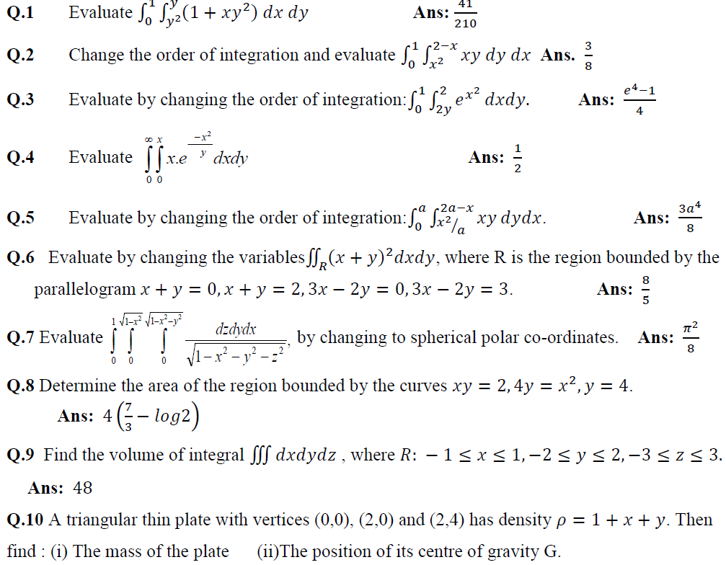
Weekly Assignment

Slide 72
Recap
Application of integrals
Area
Volume
Centre of mass
Discussion on assignment

Slide 73
Improper Integral (CO4)

Slide 74
Improper Integral of First Kind (CO4)
The definite integral is called an improper integral of first kind if either a or b or both a and b are infinite. For example:

Slide 75
Improper Integral of Second Kind (CO4)
The definite integral is called an improper integral of second kind if both a and b are finite but integrand becomes infinite at some point of the range.

Slide 76
Improper Integral of Third Kind (CO4)
The definite integral is called an improper integral of third kind if interval of integration is unbounded and f is also unbounded. For example

Slide 77
Example 1
Question:
Solution:

Slide 78
Example 2
Question:
Solution:

Slide 79
Example 3
Question:
Solution:

Slide 80
Beta and Gamma Function (CO4)
Objective
Many complex integrals can be reduced to expressions involving the beta and Gamma function.

Slide 81
Gamma Function (CO4)
Properties of Gamma Function

Slide 82
Transformations of Gamma Function (CO4)
Transformation 1:
Transformation 2:
Transformation 3:

Slide 83
Beta Function (CO4)
Properties of Beta Function

Slide 84
Transformations of Beta Function (CO 4)
Transformation 1:
Transformation 2:

Slide 85
Important Results (CO4)
1. Relation between Beta and Gamma function:
2.
3.
4. Duplication Formula:

Slide 86
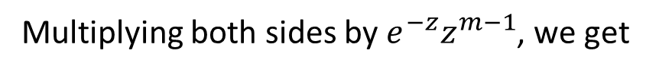
Relation : Beta and Gamma Function (CO4)
Proof:
By Gamma fn. First transformation
Replace k by z
Multiplying both sides by $e^{−z}z^{m−1}$, we get

Slide 87
Relation : Beta and Gamma Function (CO4)

Slide 88
Relation : Beta and Gamma Function (CO4)

Slide 89
Example 1
Question:
Solution:

Slide 90
Example 2
Question:
Solution:

Slide 91
Example 3
Question:
Solution:

Slide 92
Example 4
Question:
Solution:

Slide 93
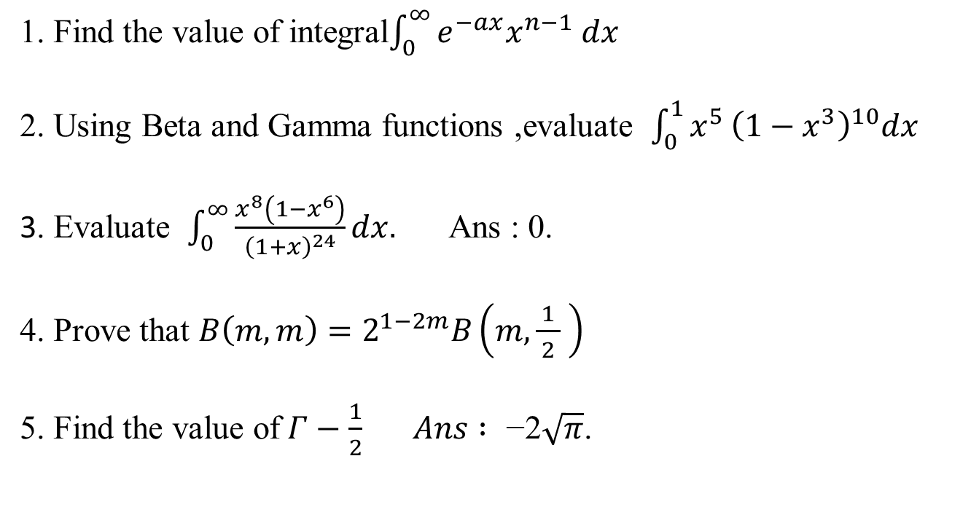
FAQ
1. Find the value of integral$\int_{0}^{∞}{e^{−ax}x^{n−1} dx}$
2. Using Beta and Gamma functions ,evaluate $\int_{0}^{1}{x^{5}}{\left(1−x^{3}\right)}^{10}dx$
3. Evaluate $\int_{0}^{∞}{\frac{x^{8}\left(1−x^{6}\right)}{{\left(1+x\right)}^{24}}}dx.$ Ans : 0.
4. Prove that $B\left(m,m\right)=2^{1−2m}B\left(m,\frac{1}{ 2 } \right)$
5. Find the value of$Γ−\frac{1}{2} Ans :\text{ −2}\sqrt{π}$.

Slide 94
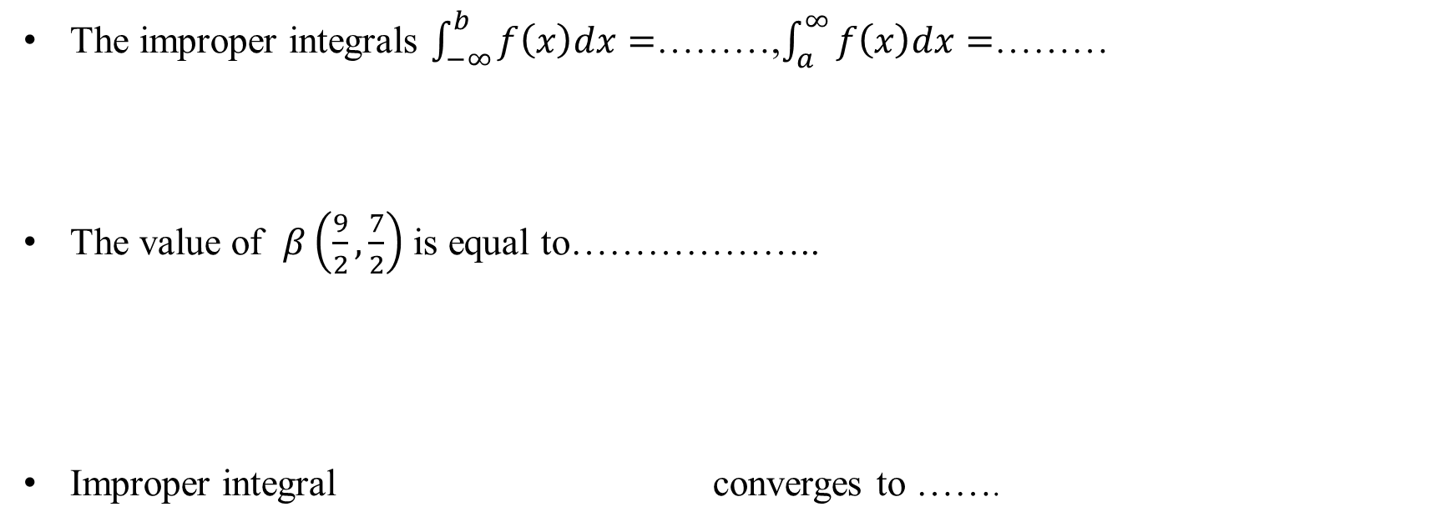
Quiz
The improper integrals $\int_{−∞}^{b}{f\left(x\right)dx}=$………,$\int_{a}^{∞}{f\left(x\right)dx=}$………
The value of $β\left(\frac{9}{2},\frac{7}{2}\right)$ is equal to………………..
Improper integral converges to …….

Slide 95
Faculty Video Links, Youtube & NPTEL Video Links and Online Courses Details
Self Made Video Link
Improper Integral
https://www.youtube.com/watch?v=obZ-xUL4S9g&t=152s
Beta and Gamma Function
https://www.youtube.com/watch?v=A_QE-duLhW0&t=904s
Youtube/other Video Links
Improper Integral
NPTEL: Lecture 21-Improper Integral
https://www.youtube.com/watch?v=kfv9h3c46CI
Beta and Gamma Function
NPTEL: Lecture Beta and Gamma Function
https://www.youtube.com/watch?v=9_m36W3cK74

Slide 96
Recap
Improper Integral
Gamma Function
Beta Function

Slide 97
Dirichlet’s Integral (CO4)
Objective
There are several types of integrals which go under the name of a "Dirichlet integral.“
Useful in finding volume and mass.

Slide 98
Dirichlet’s Integral (CO4)
where V is the region x ≥ 0, y ≥ 0 ,z ≥ 0 and x + y +z ≤1

Slide 99
Example 1
Question:
Solution: Let

Slide 100
Example 2
Question:
Solution:

Slide 101
Example 2 Contd…

Slide 102
Example 3
Question:
Solution:
Solution: Let

Slide 103
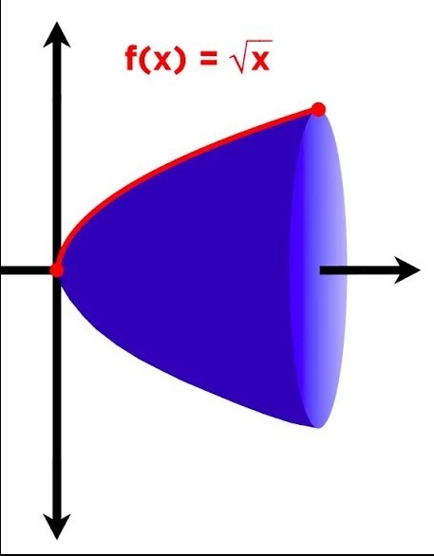
Volume and Surface of the Solid of Revolution(CO4)

Slide 104
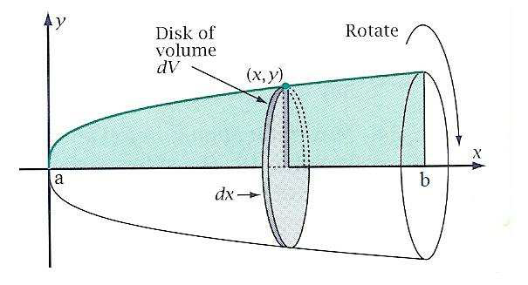
Volume of the Solid of Revolution (CO4)
About X axis: The volume of the solid generated by revolution about x axis , The area bounded by the curves y = f(x), the solid axis and ordinates x = a, x = b is-

Slide 105
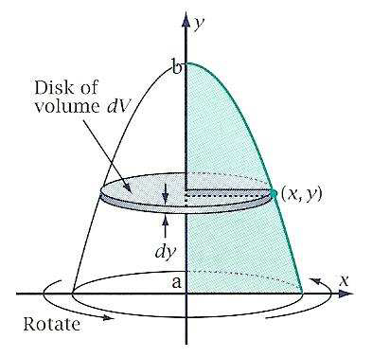
Volume of the Solid of Revolution (CO4)
About Y axis: The volume of the solid generated by revolution about x axis , The area bounded by the curves y = f(x), the solid axis and ordinates x = a, x = b is-

Slide 106
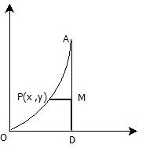
Volume of the Solid of Revolution (CO4)
About any axis:
Take any point P(x, y)on the curve and draw a perpendicular (PM) on the line about which curve is to be revolved (AD) and find length PM. Also find the distance (DM) of point M from the axis such that PM and DM are perpendicular to each other.

Slide 107
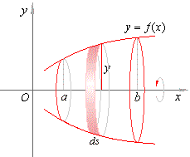
Surface of the Solid of Revolution (CO4)
The curved surface of the solid generated by revolution about the x axis of the area bounded by the curve y = f(x), x axis and the ordinates x = a, x = b is given by
s is the length of arc of the curve .

Slide 108
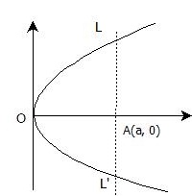
Example 1
Question:
Solution:

Slide 109
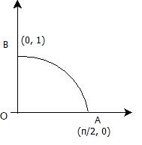
Example 2
Question:
Solution:

Slide 110
Example 3
Question:
Solution:

Slide 111
Example 3 Contd…

Slide 112
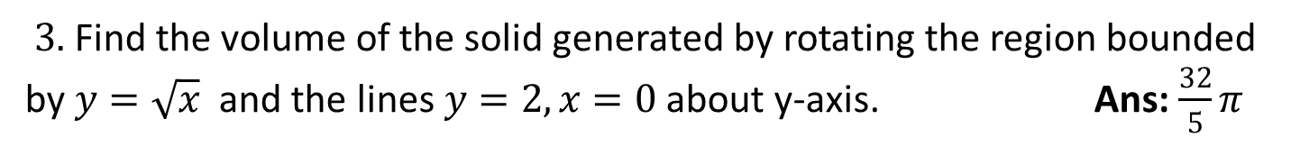
FAQ
$3.$Find the volume of the solid generated by rotating the region bounded by $y=\sqrt{x}$and the lines$y=2, x=0$ about y-axis. Ans: $\frac{32}{5}π$

Slide 113
Quiz
Dirichlet’s integral applied when…………
The volume of the solid generated by revolution about x- axis , of the area bounded by the curve y=f(x) , the solid axis and ordinates x=a ,x=b is ………….
The curved surface of the solid generated by the revolution about the x-axis , of the bounded by the curve y=f(x) , the x-axis and the ordinates x=a , x=b is ……

Slide 114
Faculty Video Links, Youtube & NPTEL Video Links and Online Courses Details
Self Made Video Link
Dirichlet’s Integral
https://www.youtube.com/watch?v=NDYVmthtWeQ&t=487s
Volume and Surface of Solid of Revolution
https://www.youtube.com/watch?v=Ej789u59JwM&t=263s
Youtube/other Video Links
Dirichlet’s Integral
IIT: Lecture- Dirichlet’s Integral
https://www.youtube.com/watch?v=HQM7XMd5QQo
Volume and Surface of Solid of Revolution
https://www.youtube.com/watch?v=R_aqSL-q6_8
https://www.youtube.com/watch?v=iUzfsUOl3-A

Slide 115
Recap
Dirichlet’s Integral
Volume by revolution
Surface area by revolution

Slide 116
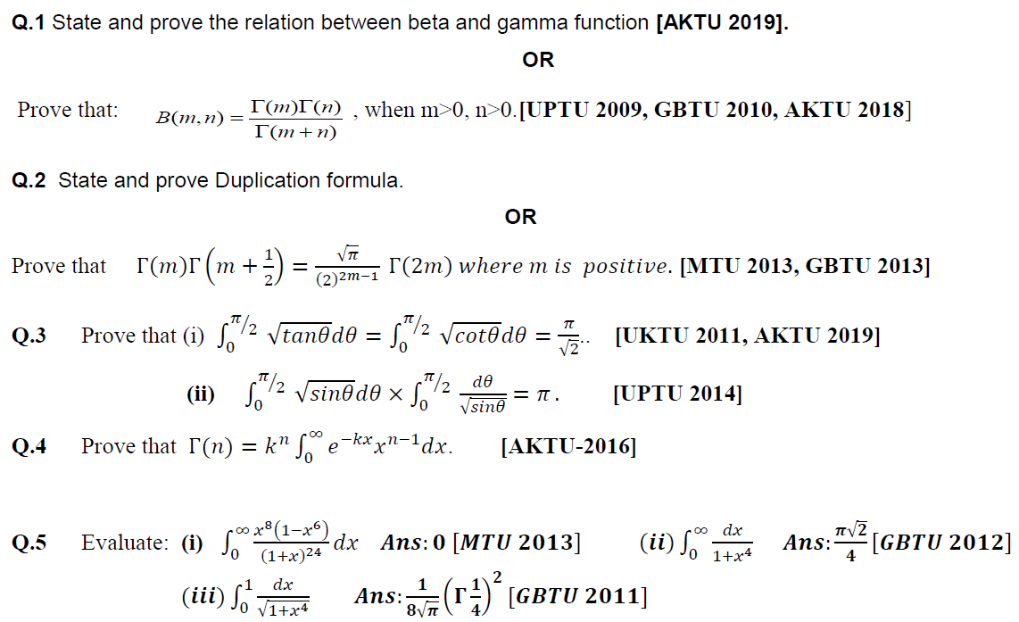
Weekly Assignment
Beta and Gamma Function

Slide 117
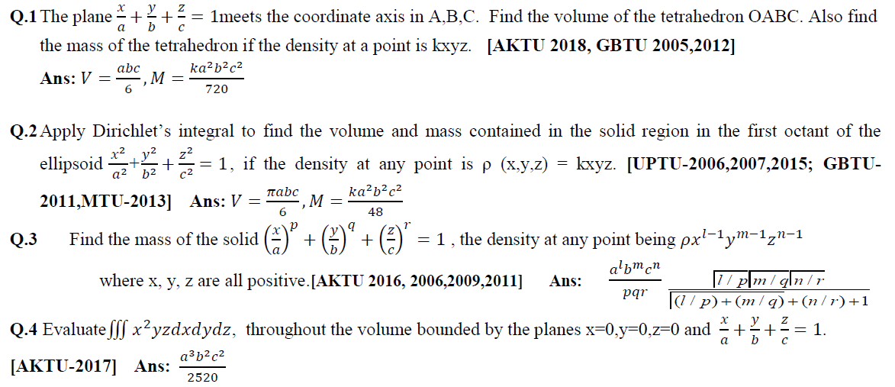
Weekly Assignment
Dirichlet’s Integral

Slide 118

Weekly Assignment
Solid of revolution:

Slide 119

MCQ
1. The value of the integral $\iint{\sqrt{x^{2}+y^{2}}}$ dxdy in xy-plane, bounded by
$x^{2}+y^{2}=4$ and $x^{2}+y^{2}=9$ is
(a) $20π/9$ (b) $30π/9$ (c) $19π/9$ (d) $38π/9$
2. The value of the integral $\int_{0}^{1}{\int_{0}^{1}{x^{2}ydx }}$ is
(a) 1 (b) 1/6 (c) 1/3 (d) None of these
3. If u= x+y and v= x-2y ,then the area element dxdy is replaced by
(a) $\frac{1}{2}$dudv (b) $\frac{1}{3}$dudv (c) dudv
(d) none of these
4. Which of the following is true
(a) $\left\lceil n+1=\left\lceil n\right.\right.$ (b)$\left\lceil n+1=n\left\lceil n \right.\right.$ (c) $\left\lceil n+1=\left\lceil n\right.\right.−1$
(d) None of these .

Slide 120

MCQ
5. The integral $\int_{0}^{∞}{\frac{x^{m+1}+x^{n+1}}{{\left(1+x\right)}^{m+n}}}dx$ is
(a) $β\left(m,n\right)$ (b) 2$β\left(m,n\right)$ (c) 3$β\left(m,n\right)$ (d) None of these .
6. $β\left(m+1,n\right)+β\left(m,n+1\right)$ is equal to
(a) $β\left(m,n\right)$ (b) 2$β\left(m,n\right)$ (c) 3$β\left(m,n\right)$ (d) None of these .
7. The value of $β\left(\frac{9}{2},\frac{7}{2}\right)$ is equal to
(a) $\frac{π}{2048}$ (b) $\frac{5π}{2048}$ (c) $\frac{1}{2048}$ (d) $\frac{1}{48}$
8. The integral $\int_{0}^{∞}{e^{−h^{2}x^{2}} dx}$ is equal to
(a) $\frac{\sqrt{π}}{2h}$ (b) $\frac{π}{2h}$ (c) $\frac{π}{h}$ (d) $\frac{π}{3h}$

Slide 121

MCQ
9. The integral $\int_{0}^{∞}{\sqrt{x}{ e}^{−x} dx}$ is equal to
(a)$Γ\frac{1}{2}$ (b) $Γ\frac{3}{2}$ (c)$Γ\frac{5}{2}$ (d) $Γ\frac{7}{2}$
10. $ΓnΓ(1−n)$ is equal to
(a) $\frac{π}{\sin{nπ}}$ (b) $\frac{1}{\sin{nπ}}$ (c) $\frac{nπ}{\sin{nπ}}$ (d) None of these
11. $β\left(m+1,n\right)+β\left(m,n+1\right)$ is equal to
(a) $β\left(m,n\right)$ (b) 2$β\left(m,n\right)$ (c) 3$β\left(m,n\right)$ (d) None of these .
12. The value of $Γ(0)$ is
(a) $1$(b) 0 (c) -1 (d) None of these

Slide 122

Old Year Paper-2019 (KAS-103)
Section A
Section B
Section C

Slide 123

Old Year Paper 2019(KAS 203)
Section A
Section B
Section C

Slide 124
Old Year Paper 2019 (KAS-103)
PDF ATTACHED

Slide 125
Old Year Paper 2018 (NAS-103)
PDF ATTACHED

Slide 126
Old Year Paper 2017 (RAS-103)
PDF ATTACHED

Slide 127

Expected Questions for University Exam
Evaluate by changing the order of integration:$\int_{0}^{1}{\int_{2y}^{2}{e^{x^{2}}}}dxdy.$
Change the order of integration and evaluate $\int_{0}^{1}{\int_{x^{2}}^{2−x}{xy dy dx}}$
State and prove the relation between beta and gamma function .
State and prove Duplication formula.
Apply Dirichlets integral to find the volume and mass of an octant of the ellipsoid $\frac{x^{2}}{a^{2}}+\frac{y^{2}}{b^{2}}+\frac{z^{2}}{c^{2}}=1$, the density at a point being $ρ=kxyz$.
Find the volume generated by revolving the ellipse $\frac{x^{2}}{a^{2}}+\frac{y^{2}}{b^{2}}=1$ about x –axis.
A solid is in the form of the positive octant of the Sphere$x^{2}+y^{2}+z^{2}=a^{2}$. The density at any point (x, y, z) is given by k xyz, where k is constant. Find mass and the co-ordinates of the centre of gravity of the solid.

Slide 128
Summary
Course Objective
COs and POs of subject
Mapping of COs and Pos
Prerequisite and Recap
Multiple integration
Double integral
Triple integral
Change of order of integration

Slide 129
Summary
Change of variables: Polar form, Spherical form, Cylindrical form
Application: Areas and volumes, Center of mass (Constant and variable densities)
Improper Integral: First Kind, Second Kind, Third Kind
Beta and Gama function
Dirichlet’s Integral
Solid of revolution: Surface area and Volume

Slide 130
Summary
Quiz
Faculty Video Links, Youtube & NPTEL Video Links and Online Courses
MCQs
Old Sessional Papers
Old University Question Papers
Expected Questions for University Exam

Slide 131
References
E. Kreyszig, Advance Engineering Mathematics, John Wiley & Sons, 2005.
Peter V. O’Neil, Advance Engineering Mathematics, Thomson (Cengage) Learning, 2007.
Maurice D. Weir, Joel Hass, Frank R. Giordano, Thomas, Calculus, Eleventh Edition,Pearson.
D. Poole, Linear Algebra : A Modern Introduction, 2nd Edition, Brooks/Cole, 2005.
Veerarajan T., Engineering Mathematics for first year, Tata McGraw-Hill, New Delhi, 2008.
Ray Wylie C and Louis C Barret, Advanced Engineering Mathematics, Tata Mc-Graw-Hill; Sixth Edition.
P. Sivaramakrishna Das and C. Vijayakumari, Engineering Mathematics, 1st Edition, Pearson India Education Services Pvt. Ltd.

Slide 132
Thank You

